Slide 1

You Want Snakes? Because That’s How You Get Snakes.
Terraform antipatterns in the wild
Jason Brown – jasbro@jasbro.io
Notes:
OK, so this talk is not an exhaustive list of terraform antipatterms or best practices – it is a little discussion and rant on some of the most common antipatterns I’ve been seeing of late. I’ve been in the business over 20 years now, doing ”DevOps” for about the last ten. I’ve been at a bunch of organisations using Terraform, and I don’t think a single one of them is doing terraform WELL – even the ones I’ve architected.
One last note before we get into it: there’s no blame here. If you’re doing on of these things, I’m sure you have your reasons. But I hope by the end you’ll at least consider maybe looking at your Terraform and start picking away at the bad things. Right. So why is this talk called what it’s called? We’ll find out in Antipattern #1, but first an intro

Slide 2

ME:
Jason Brown
Head of Infrastructure (incoming),
GoodHuman
In DevOps since 2013ish
@cloudyopspoet on Twitter
Formerly of: Microsoft, Octopus Deploy, Domain Group, Bunnings, Ento, WithYouWithMe, Fujitsu, Dimension Data… blah blah blah
Notes:
I am Jason Brown
Currently DevOps Manager at WithYouWithMe
In a few weeks, Head of Infrastructure at GoodHuman
This talk is Version 0.1
A discussion piece probably never going to be finished
It exists because I’ve been through a bunch of different organizations over the last few years, and every one of them seems to have been inviting Terraform disaster in one way or another. The examples that follow are based on real-life issues, but I haven’t, of course, been able to share the original source code with you. I’ve recreated it where I can, but in some cases, you may have to use your imagination

Slide 3
THIS TALK:
0.0.1 Public beta
Mostly my stupid opinions
A discussion piece
Will probably change every time I deliver it
All these antipatterns and code smells come from real workplaces
No I will not identify those workplaces by name…
Notes:
I am Jason Brown
Currently DevOps Manager at WithYouWithMe
In a few weeks, Head of Infrastructure at GoodHuman
This talk is Version 0.1
A discussion piece probably never going to be finished
It exists because I’ve been through a bunch of different organizations over the last few years, and every one of them seems to have been inviting Terraform disaster in one way or another. The examples that follow are based on real-life issues, but I haven’t, of course, been able to share the original source code with you. I’ve recreated it where I can, but in some cases, you may have to use your imagination. Oh and also, I’ve probably done MOST IF NOT ALL of these, this is not me being holier-than-thou
So with that let’s get on to antipattern #1 and explain why this talk is called what it is

Slide 4

ANTIPATTERN #1: FIRE AND FORGET
Notes:
FIRE and FORGET. That is, folks who write up a bunch of terraform, or maybe copy and paste it from a website, run it once to set up the infrastructure…. Then do nothing else with it. The biggest strength of Terraform is in Drift detection and Correction – if you’re not applying your terraform over and over, you don’t get that strength. And what does this have to do with snakes? I lived in the country for a few years, up in NE Victoria. I had a big old lawn front and back, and I was fairly lazy in mowing it. In fact, I don’t think I mowed it at all for the first few months. After a while, a mate at the pub asked me why I hadn’t mowed my lawn lately. I attempted to explain that I wasn’t really bothered, it was nice to leave it a bit natural and besides, I’m lazy. He replied “So… you want snakes? Because that’s how you get snakes”. Which was a surprise. I – city kid – hadn’t thought about that at all. I
If you don’t mow your lawn regularly when you’re out in the country, you’re creating a lovely environment in which small critters can roam around unseen, and where there are small critters, there are predators. Snakes will arrive. And it’s the same with terraform. You need to run it regularly to check and correct your infrastructure, otherwise small changes will creep in, and where small changes multiply, eventually bigger and worse ones will arrive. Sure enough, one morning a few weeks after that conversation, I stepped out my front door with my dog to find a 3ft red-belly sunning itself on my driveway. Shortly after, I bought a lawnmower. No more snakes. So that’s Antipattern #1, and I hope nobody here is doing that.

Slide 5

ANTIPATTERN #2: RUNNING TERRAFORM
ON YOUR LAPTOP
Notes:
RUNNING TERRAFORM ON YOUR LAPTOP
OK, this one is gonna be way more common than the last one. Show of hands, how many people run terraform apply from their local workstation. WHY?? There’s only one reason you would be doing this, and that’s if you’re the only engineer in your entire company. And even then, I’d say you probably don’t want to, and I’ll explain why in a second Now, let’s try and explain this. There are lots of reasons not to do this 1. dependencies. You probably need credentials, env variables, a bunch of different secrets and things. Terraform credentials, by their nature, are god mode. DO you really want to have to set these up on your local laptop? On every laptop you or your team use? Can you guarantee one of your colleagues won’t accidentally change one and screw something up? 2. Branch control How do you guarantee what you’re running locally is the right VERSION of your terraform? We have good solutions for this, using git, we can have a “main” branch, which is our known canonical state. How do you guarantee that nobody accidentally runs “develop” or “enh/mycrazyexperiment” instead though, even by accident? 3. Contention
Yes, state locks exist, but how can you be sure you and your colleague aren’t trying to run the same terraform config against AWS?
4. Visibility
How do you know what’s been applied where and when? There’s no records or logs expect whatever you have in your console on your laptop. 5. State Lock Hell Every time I’ve had to go an manually unlock a state file, it’s been because someone triggered it from their laptop, realized they’d screwed something up and cancelled The answer? You put your terraform in a CI pipeline. That way, your devs don’t necessarily need secrets on their local laptop. There’s no contention, there’s no risk, you retain logs and you’re less likely to end up in locking hell. And you can guarantee you ONLY apply from a blessed branch, be that main, master, or whatever.

Slide 6
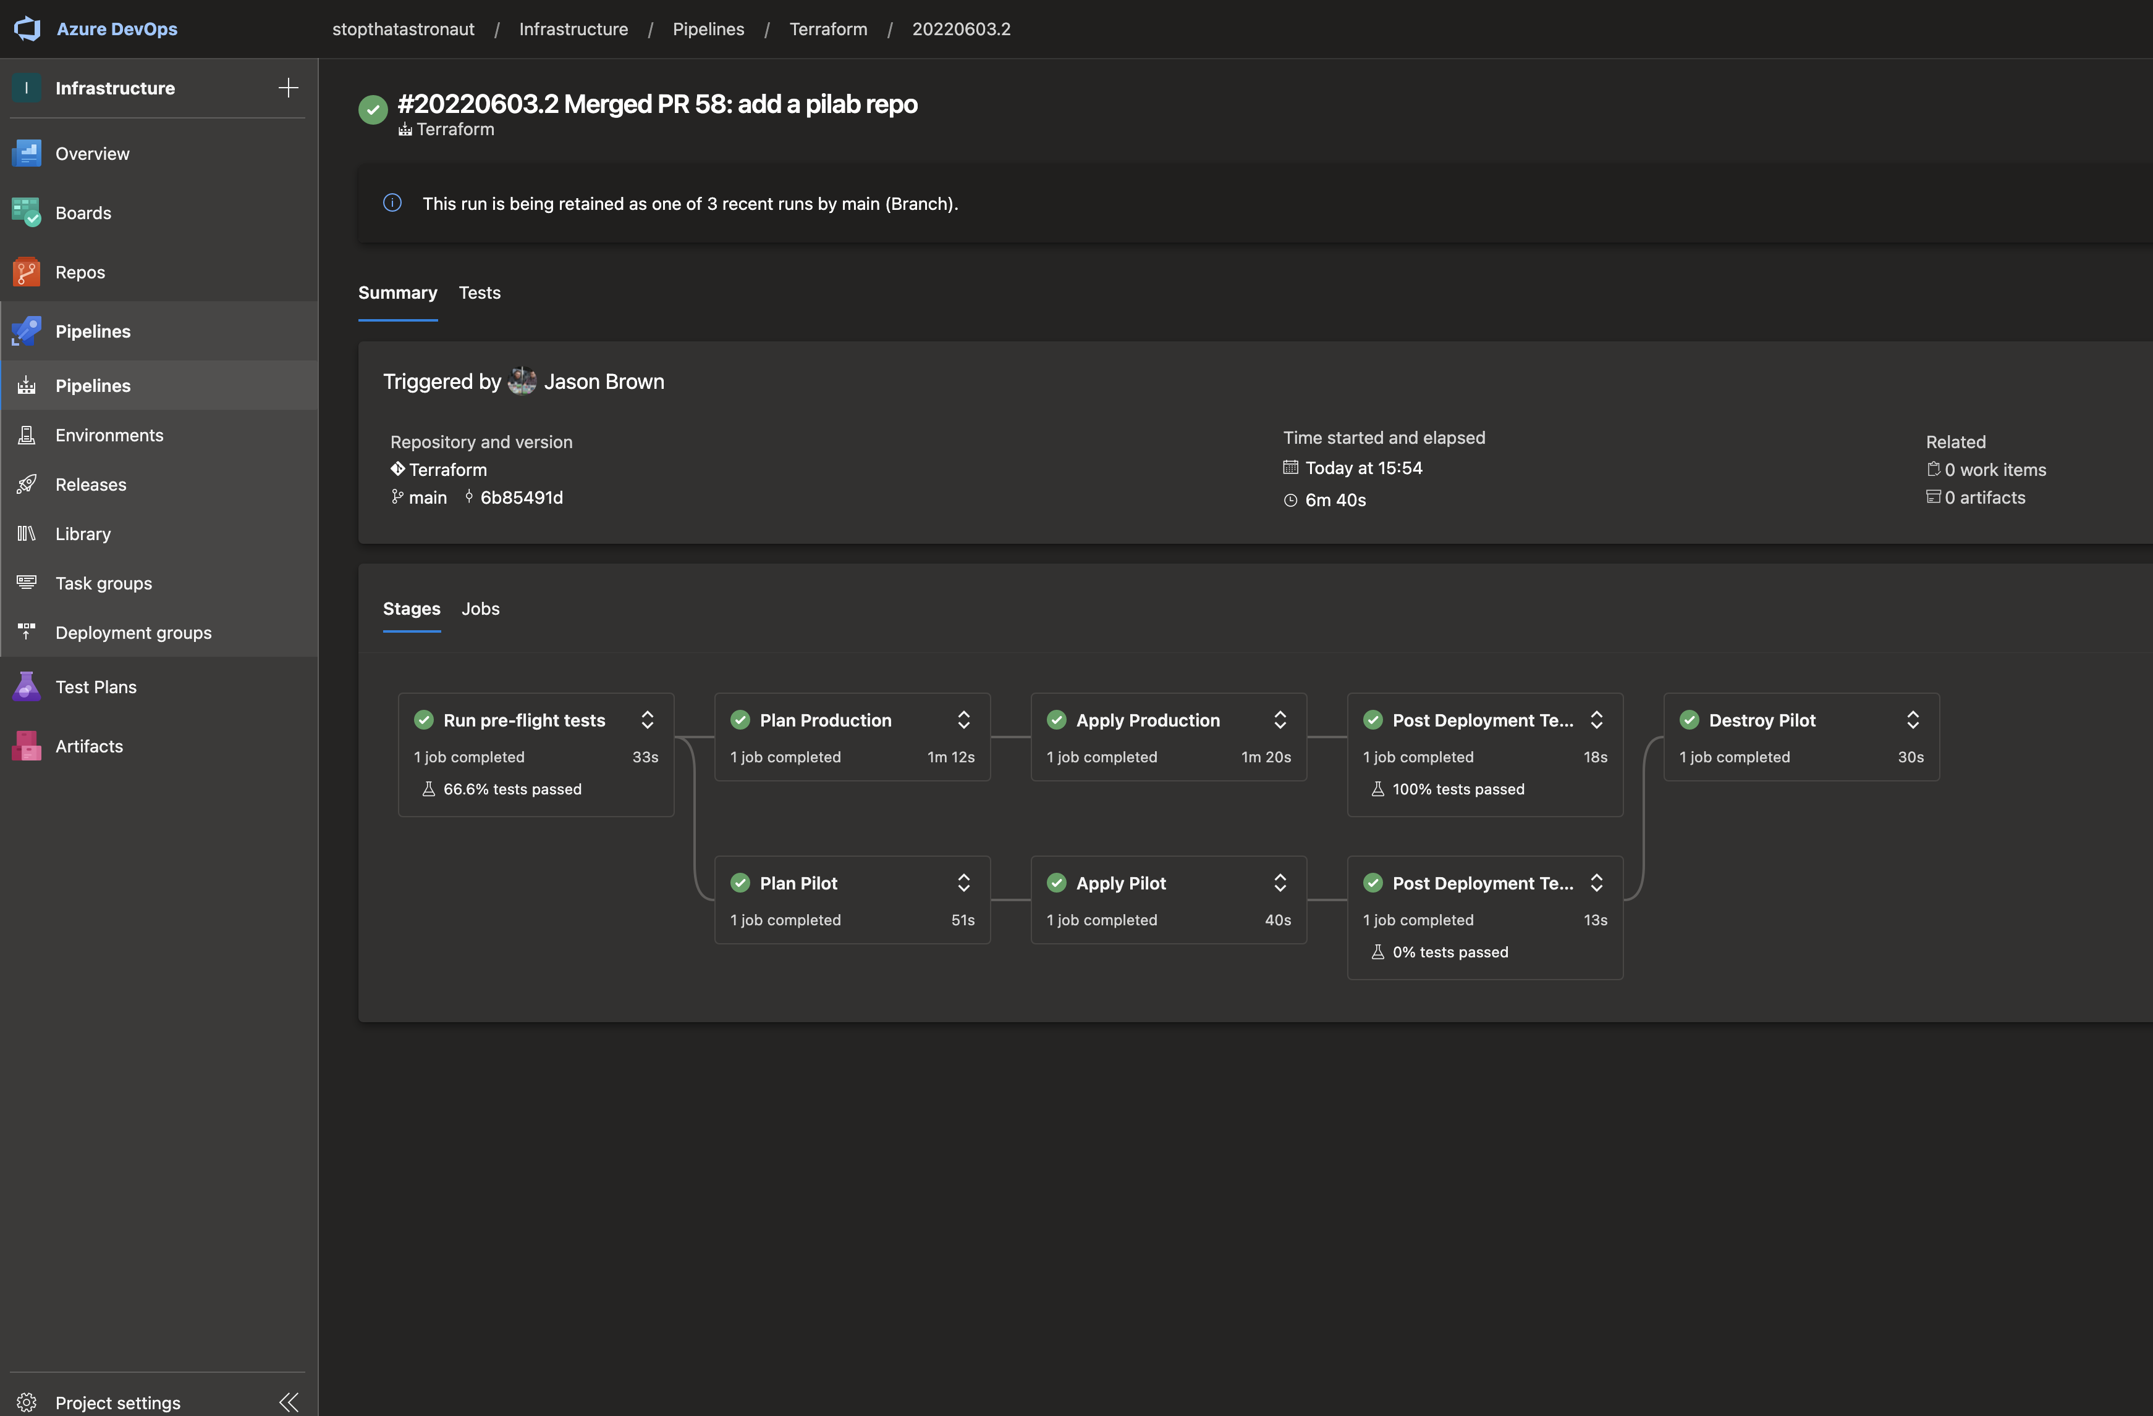
Notes:
Here’s my side-hussle pipeline, in Azure devops. I’m the ONLY engineer in this company. My workflow here is pretty simple. I start a branch in git, I make my changes, I push the branch and I open a pull request The CI pipeline runs PLAN I check it’s working as I expect. I can run plan locally again if I want to tighten up the feedback loop a bit. Once I’m happy, I merge, the pipeline runs apply across everything
You can see I have two accounts there, Production and Pilot, they map to two Azure accounts I own, but this also controls an AWS account, a github organization, My circleCI account, my gitlab account and my StatusCake endpoint monitoring. If I want to make a change, I just pop open VS Code and I change it, then merge the PR. I can demo this live later if you like, but I’ve built similar pipelines in CircleCI, TravisCI and Github actions.
There are lots of cool things you can do in here, FWIW. At work, we run infracost in the pipeline, so our pull requests always include a cost estimate. We also run Pytest against a generated JSON plan, just to check that things are the way we expect them to be, and we also run live tests afterwards to make sure our infra is up and running as expected. All the boring bits are automated so I don’t have to think about them.
IN fact, I HAVE upgraded this pipeline since the screenshot was taken, and now it uses infracost to generate cost estimates (see next screenshot)

Slide 7
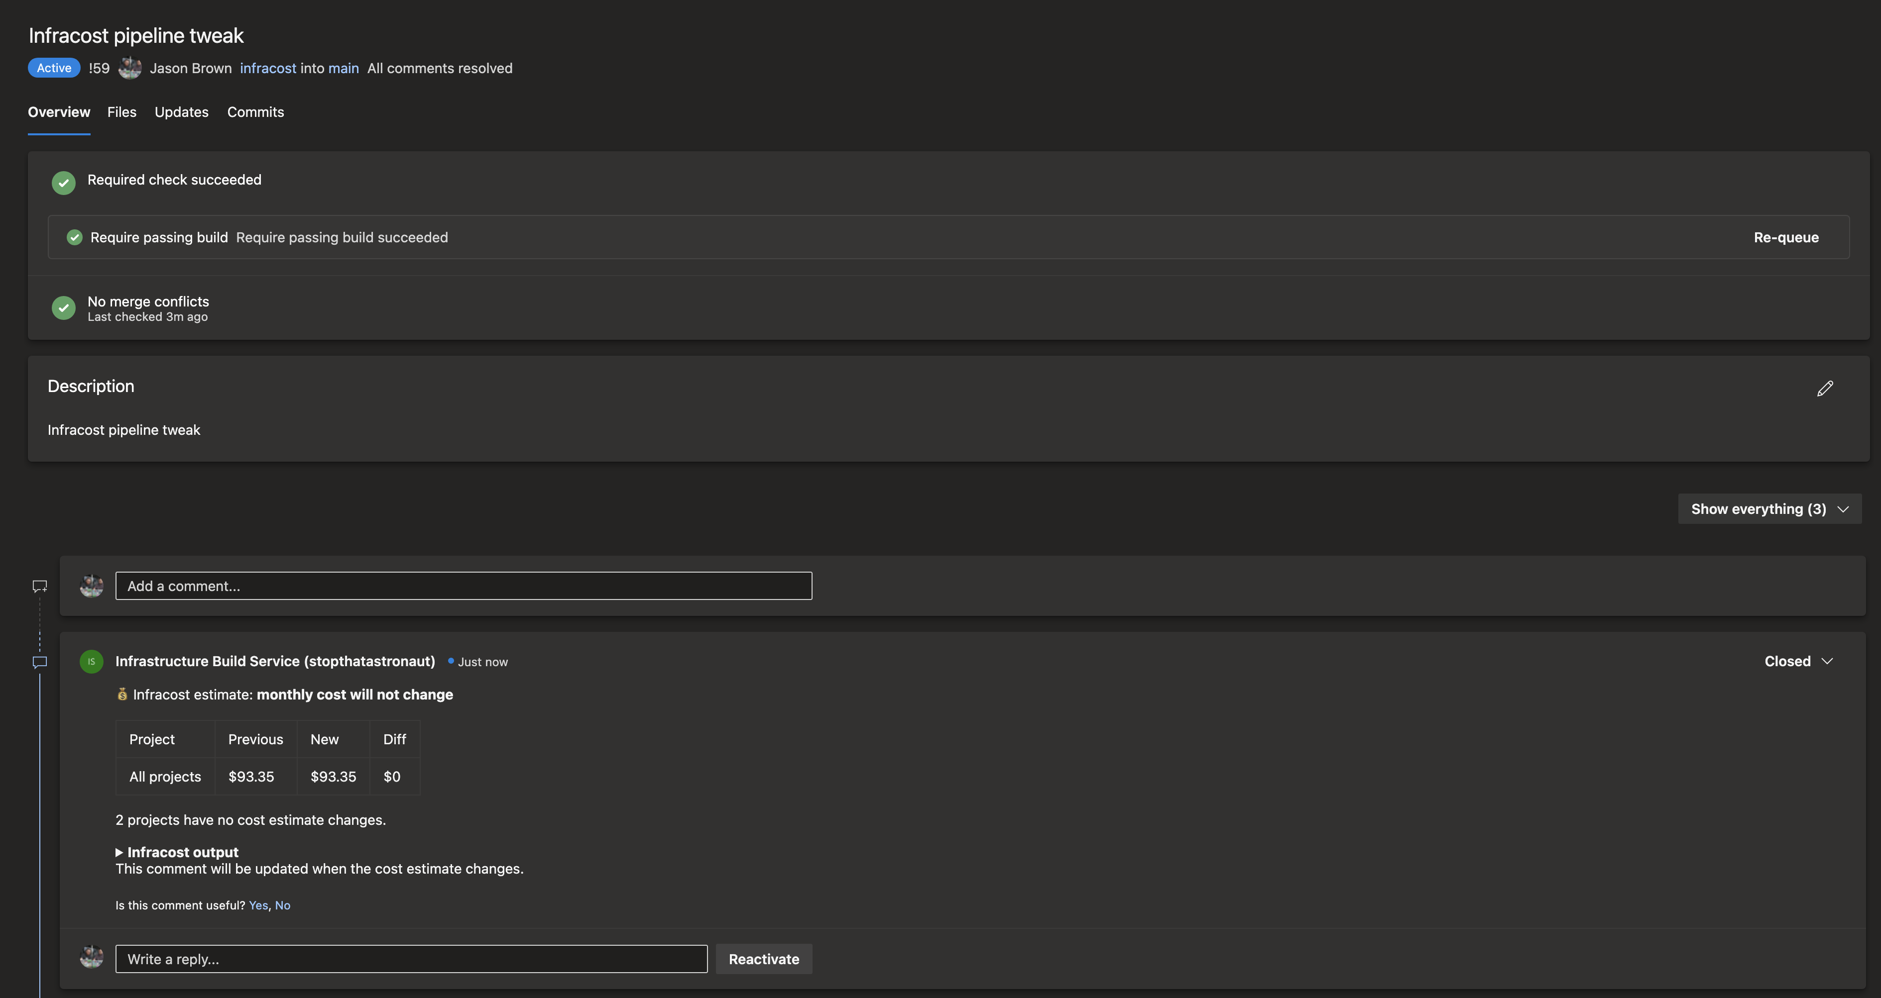

Slide 8

ANTIPATTERN #3: MODULES THAT
AREN’T REUSABLE
Notes:
I HAVE SOME EXAMPLES OF THIS
I think Hashicorp themselves may be to blame for this. A top-level terraform config, in Hashicorp training, is called a module. A reusable module, what we might think of as a library, is a “child module”. Linguistically, there’s only a subtle difference between your top-level module, and any allegedly reusable child modules it uses. This leads to some IaC developers tightly coupling the parent and the child module, to the extent that the child module is not usable outside the top-level module. Something less common but more insidious is the hard-coding of values inside a child module, so that if you pick it up, copy it to another repo and try to re-use it, you run into name collisions, region breakages, unresolved dependencies and other general horror. Think, for example, of a module that hardcodes an S3 bucket name. Yes, I’ve seen those. They’re modules that can only be used ONCE across the entire globe. Less spectacular, perhaps, may be hard coded DNS zones or other lazy practices which totally work if your child module stays where you first wrote it, but cause all manner of heartache when you try to re-use the module. So the tip here: IF YOU’RE WRITING A CHILD MODULE, START FROM THE PRINCIPLE THAT YOU ARE BUILDING A LIBRARY FOR ANYONE TO USE. Imagine you’re going to be releasing it to the internet at large, and you’ll create better modules.

Slide 9
ANTIPATTERN #4: OVERRELIANCE ON VARIABLES
Notes:
This one might spark some discussion, because it’s DEFINITELY my opinion.
I don’t like tfvar files (they make running in CI pipelines tricky)
I don’t like sending in vars from the command line if I can possibly avoid it
Every extra parameter you add is a chance to screw up a parameter ESPECIALLY if the rest of your workflow relies on an engineer routinely typing something in. I’ve seen terraform modules where the AWS region and AZ are liberally scattered throughout tfvar files when they could literally be pulled from the config as data – and there are LOTS of things that can be pulled as data or as resource references. Keep your parameters and tfvar files as small as you possibly can, because once they get big, they get unreadable
In fact, I would generally argue that if your tfvar files are getting large, it’s time you broke out into child modules and passed your data in in the module declaration, with some sensible defaults to cut down boilerplate.
Also, Workspaces are a thing, and the

Slide 10

ANTIPATTERN #5
> terraform apply -target="s3_bucket.my_pet_resource"
Notes:
Remember the bit about not mowing your lawn? Well this is the equivalent of mowing a tiny patch of lawn just outside your back door and leaving the rest looking like the nethers of a 1970s porn star why do this?? I was at a nameless company a while back who only ever did this. They’d let drift get so far out of control that they only ever applied one or two resources at a time. And these guys were a PCI-compliant fintech startup with a LOT of responsibilities around data security. And yet they’d lost control of their IaC to the extent they were laboriously applying single resources at a time. If you ever have cause to use this switch, question your life choices – there are very rare times you might want to use it, for example if recovering or migrating a horribly broken state, but in general, it would have been much better if you’d put your terraform in a CI pipeline in the first place and had the entire thing run every time you change some code.
This switch has a genuine use case and that use case is generally “EVERYTHING IS ALREADY BROKEN AND I HAVE TO FIX IT STEP BY STEP”. Question your life choices.

Slide 11

ANTIPATTERN #6: Y U NO VERSION YOUR MODULES??
Notes:
I’ve only actually seem properly versioned custom modules at one workplace in the last five years and that’s because I made them that way. The majority of modules I see usually reside in the same repo as the code that calls them, and come the day you want to upgrade a module without instantly applying the change across every single instance all at once, you’re going to have to do a ton of work to get there.
If you can’t actually publish your modules to the Terraform Registry, consider putting your modules into their own git repos and versioning them with git tags. Or use Gitlab, which gives you Terraform registries right there next to your CI. Github works fine but any git provider can use tags and Terraform can consume modules from there. And then you can upgrade a single instance. Let’s look at an example!

Slide 12
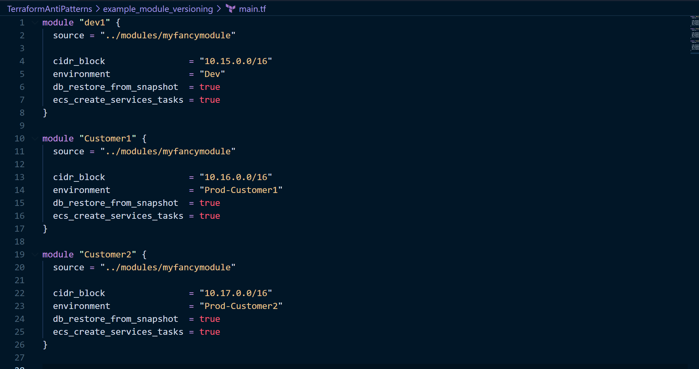

Slide 13
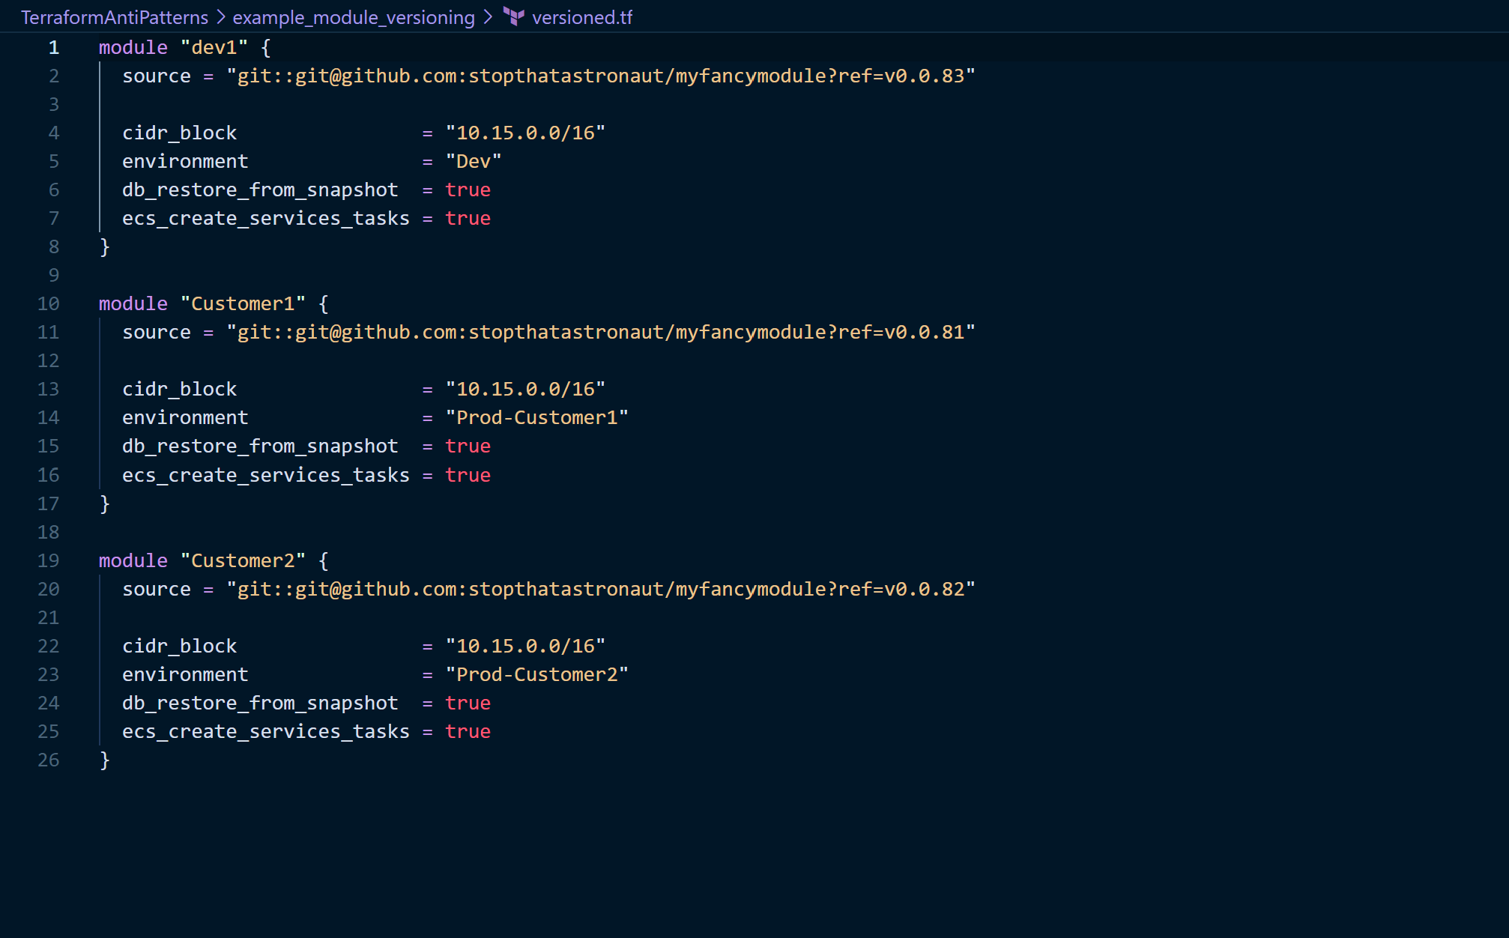
Notes:
It’s pretty easy to do. You can also use

Slide 14

DISCUSSION TIME: WHAT HAVE YOU SEEN
THAT DRIVES YOU MAD?
Notes:
Chevrons to failure? Wrapper scripts in place of workspaces?
Repetition of hardcoded variables instead of resource references?
Poor to no documentation or comments (put Terraform-docs in your pipeline!)

